Slide 1
CLOUD BASED BIOMETRIC SECURITY FOR ORGANIZATIONS
BATCH NUMBER - 14
TEAM MEMBERS
aBHINAYA R(211417104002)
PRIYANKA B(211417104204)
ABITHA C(211417104004)
PROJECT GUIDE
Mrs. r . Salini (M .TECH)
Assistant professor,
Department of cse

Slide 2
ABSTRACT
The main aim of the project is used to derive a unique identity from the users biometric data which is further used to generate the user’s private key.
In this project, a new biometric-based authentication protocol is designed to provide secure access to a remote (cloud) server.
An efficient approach to generate a session key between two communicating parties is proposed using two biometric templates for a secure message transmission.
There is no need to store the user’s private key anywhere and the session key is generated without sharing any prior information.

Slide 3
LITERATURE SURVEY
S.NO | YEAR | AUTHOR NAME | TITLE | MERITS | DEMERITS
1. | Published in journal (2019) | Wencheng Yang, Song Wang,Jiankun Hu, Guanglou Zheng and Craig Valli | Security and Accuracy of Fingerprint-Based Biometrics: A Review | One of the advantages of biometric cryptosystems is that they can bind or directly generate a cryptographic key, which can be used for both authentication and data encryption. | It is infeasible or computationally difﬁcult to retrieve raw template data.
2. | Published in conference(2018) | Zhihua Xia, Xingming Sun, Neal N. Xiong | A Novel Weber Local Binary Descriptor for Fingerprint Liveness Detection | The method consists of two components: the local binary differential excitation component that extracts intensity-variance features and the local binary gradient orientation component that extracts orientation features. | The calculation model of local binary pattern (LBP) to improve the two components of the original WLD. The proposed WLBD overcomes the two imperfections of WLD and performs well in the FLD problem

Slide 4
S.NO | YEAR | AUTHOR NAME | TITLE | MERITS | DEMERITS
3. | Published in conference (2018) | Srinivas Jangirala, Mohammad Wazid | Anonymous Lightweight Chaotic Map-Based Authenticated Key Agreement Protocol for Industrial Internet of Things | A registered user is facilitated to update password & biometrics without the involvement of the GWN. The scheme is very efﬁcient as it uses only cryptographic hash function along with the symmetric encryption/decryption. | we present a new three-factor anonymous lightweight authentication protocol suitable for IIoT. The proposed scheme applies chaotic map and fuzzy extractor techniques. A user can access the information of any smart device of monitoring group through the central controller.

Slide 5
S.NO | YEAR | AUTHOR NAME | TITLE | MERITS | DEMERITS
4. | Published in journal (2017) | Mohammad Wazid, Neeraj Kumar, Mauro Conti, Minho Jo | Design of Secure User Authenticated Key Management Protocol for Generic IoT Networks | Different Scanners capture different feature so fingerprints with varying sizes. For higher accuracy, the network must be trained individually for each scanner. | Although transfer learning is an efficient approach to machine learning problems with a limited number of training samples, it has a disadvantage in that the computation time cannot be smaller than the pertained networks.
5. | Published in Journal (2017) | Ho yub jung1, Yong seok heo2, Soochahn lee | Fingerprint liveness detection by a template-probe convolutional neural network | The ﬁngerprint scanners used in this paper produce grayscale ﬁngerprint images with a white background and a dark foreground. For higher accuracy, the network must be trained individually for each scanner. | It has a disadvantage in that the computation time cannot be smaller than the pertained networks.

Slide 6
PROPOSED AND EXISTING SYSTEM
EXISTING SYSTEM
PROPOSED SYSTEM
In existing system uploading and sharing file among multiple client user in cloud environment is very hard to perform and there is no proper authentication among the cloud user and to the cloud server.
Hence the file that uploaded on the cloud would not be secure as there is a lot of security problem that related to the cloud storage.
In the authentication phase, we capture a new biometric ﬁngerprint image of the user, and subsequently generate the private key and encrypt the biometric data as a query
In Proposed system, we introduced secure and efficient ﬁle storage and sharing cloud environment using Remote cloud.
Mutual authentication is very important between two target device as the user and to the cloud server as mutual authentication makes the server to trust the cloud storage where cloud owner can store the data and from server end, server will verify the user credential to provide any service to that particular user.
Cloud contains the encrypted information along with the parameter related to that file. If any user request to the cloud server with some attribute. Based on the attribute cloud will redirect

Slide 7
HARDWARE REQUIREMENTS :
Hard Disk : 250GB and Above
RAM : 4GB and Above
Processor : i3 and Above
SOFTWARE REQUIREMENTS:
Windows 10
JDK 1.8
My SQL 5.0
Tomcat 9
TECHNOLOGY STACK
J2EE(JAVA,JSP,JSTL,JSON)
JavaScript , HTML , CSS
Spring MVC

Slide 8

SYSTEM ARCHITECTURE
KGC (Key Generation Centre)
Server Key
User Fingerprint Data Repository
Access private key
Session key generation
Service request
Owner Registration and Mutual Authentication
Key Request to Encrypt File
User Registration and Mutual Authentication
File Download
Cloud User as Data Owner
Fingerprint Biometric
Cloud User as Data Consumer
Upload File

Slide 9
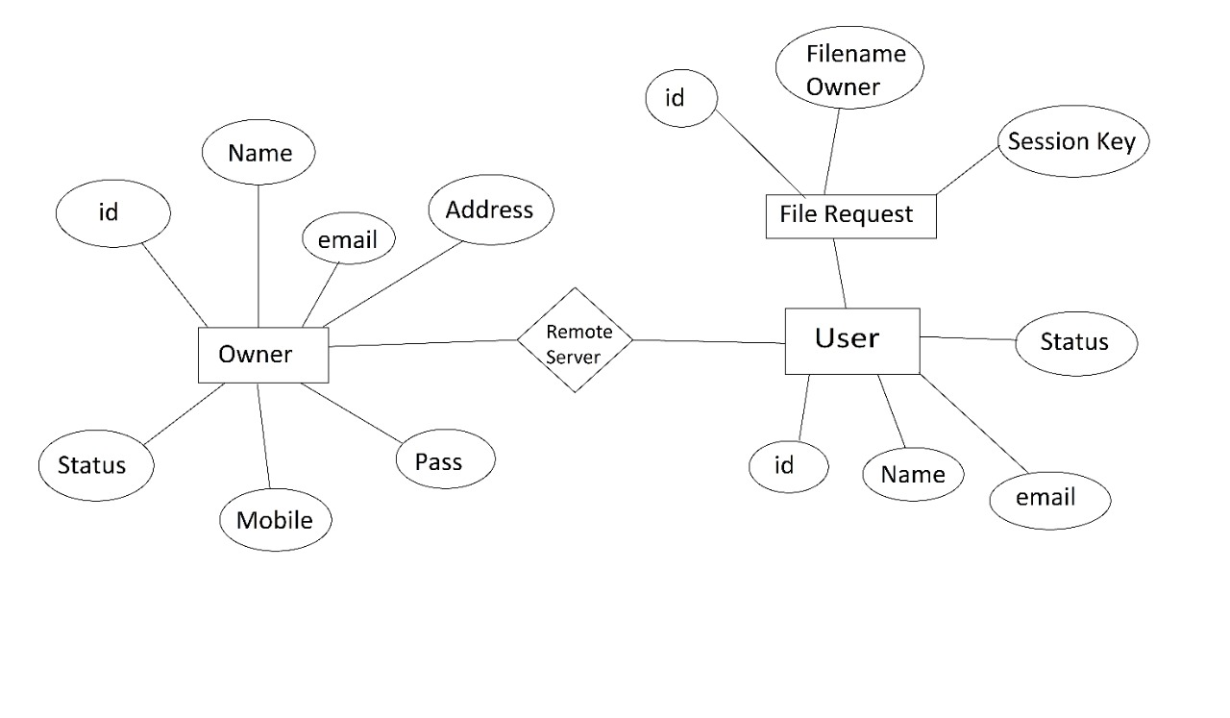
SYSTEM DESIGN
ER DIAGRAM

Slide 10
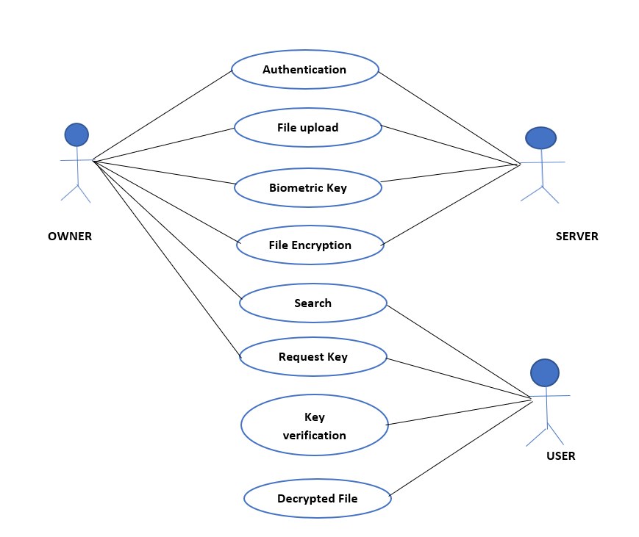
UML DIAGRAMS
USECASE DIAGRAM

Slide 11
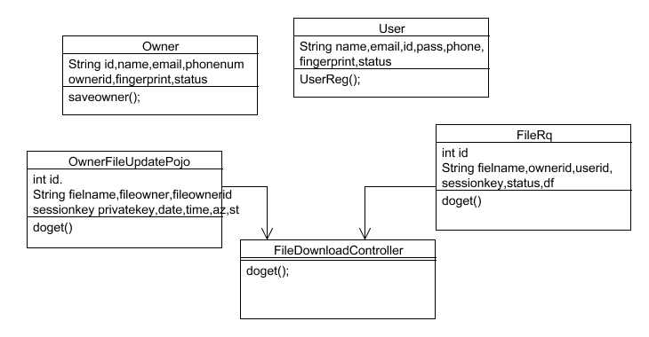
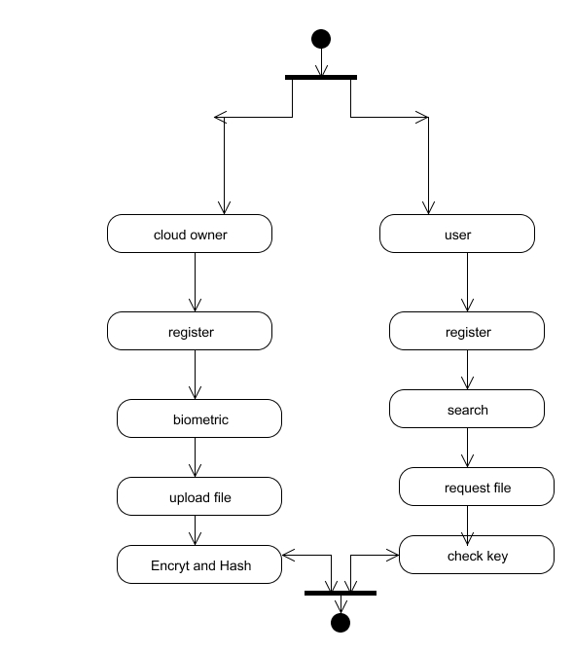
CLASS DIAGRAM
ACTIVITY DIAGRAM

Slide 12
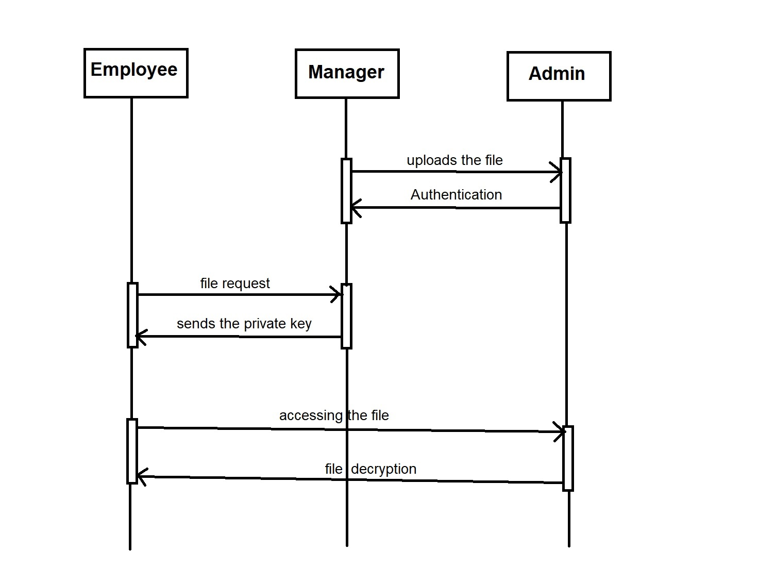
SEQUENCE DIAGRAM

Slide 13
DATA FLOW DIAGRAM
DFD LEVEL 0:
Owner /user
Register
Biometric
Generate key
Remote Server
DFD LEVEL 1
Server
Owner
User
Authentication
Proceed

Slide 14
DFD LEVEL 2:
Owner
Upload file
Bio key
Encrypt key
Server key verification
DFD LEVEL 3:
User
Search
Request File
Key sent
User view file

Slide 15
Cloud Owner and User Registration
Key Generation
Cloud Owner Upload File to Remote Cloud Server
Cloud User Decrypt and Download file
MODULES
ALGORITHM
RSA algorithm
Base 64
Diffie Hellman algorithm

Slide 16
CLOUD OWNER AND USER REGISTRATION
Initially user need to create a account in the cloud sever by providing all the necessary information related to the user email id, mobile number, age name, password and Cloud Owner a biometric ﬁngerprint.
Using BASE 64 ALGORITHM , fingerprint of the owner is converted into hash bit and stored as hash code in a remote server , then server will generate a unique identity for that Owner and User.
We introduced secure and efficient ﬁle storage and sharing cloud environment using Remote cloud.

Slide 17
KEY GENERATION
Once owner uploaded the file , the user will request for the file .
With the help of key generation Centre , a unique id that was generated by the server will be provided to the user by the owner.
Using DIFFIE HELLMAN ALGORITHM , a secure key is provided by the key generation Centre.
User can access the cloud data only if he registers their name in key generation Centre.

Slide 18
CLOUD OWNER UPLOAD FILE TO CLOUD SERVER
Using RSA ALGORITHM , user can able to upload any file in the cloud in order to provide security to the file user need to encrypted the file in the cloud .
Cloud contains only the encrypted format information about the file and corresponding parameter related to the file.
In order to maintain security user initially generated the parameter related to the file and along with the mode to upload the data as public or private if private then user need to specify the client or mention group of people who can access or download the file then based on these parameter RSA Algorithm will generate a key and sent to the user, User would encrypt the file and upload to server.

Slide 19
DECRYPT AND DOWNLOAD FILE
Then User would search the file based on the parameter if any parameter match in the server, then the server will load the entire related file to that parameter.
Before download any file from the sever the user would also need to mutual authentication to the server, if user ﬁngerprint authenticated to the server then he access the file as file is in encrypted format user need to decrypt the file to decrypt the file user request to KGC (Key Generation Centre) for key along with the file parameter and user attribute then user can able to download the file.

Slide 20
PERFORMANCE TESTING
Test case ID | Test Cases | Priority | Precondition | Input Test Data | Fingerprint | Actual Result | Test Cases Status
1. | Owner and user registration | A | Owner and user must have registered and updated their fingerprint. | Name, Email id, Mobile number , Address, Password, Fingerprint | Updated | Owner and user details have been registered | Pass
2. | File Upload | B1 B2 | Owner should logged in into their website and upload the files. Owner should logged in into their website and upload the files | Email , Password, Fingerprint. Email , Password, Fingerprint. | Matched Not Matched | Enters to the page where the file has to be uploaded. Fingerprint does not match. | Pass Fail
3. | User Request | C1 C2 | User should be logged into their website and select the file to be requested. User should be logged into their website and select the file to be requested | Email , Password, Fingerprint. Email , Password, Fingerprint. | Matched Not Matched | Enter to the page where the file can be requested. Fingerprint does not match. | Pass Fail
4. | File Decryption | D | Owner must provide the private key to the user who requested for the file downloaded. | Private Key | Matched | User enters to the page where the file has to be downloaded. | Pass

Slide 21
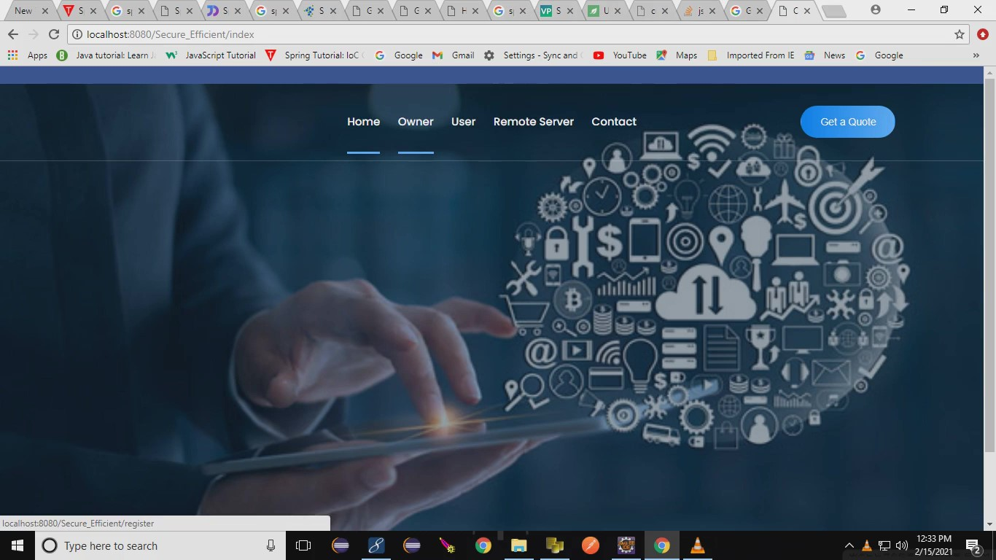

Slide 22
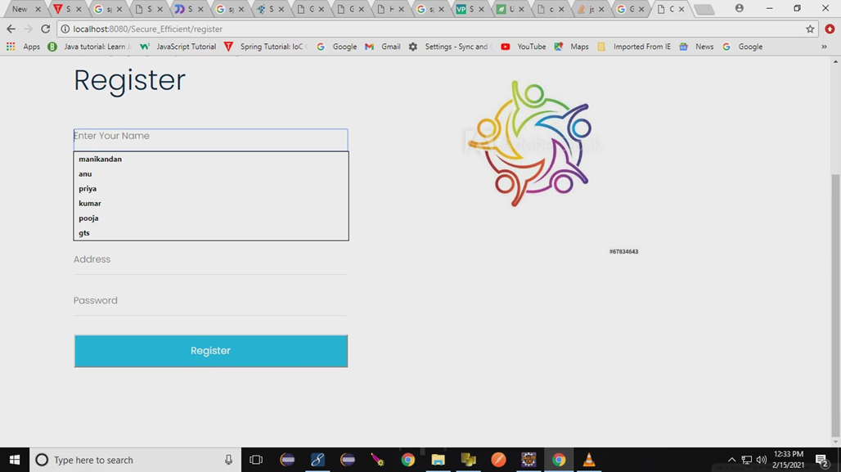

Slide 23
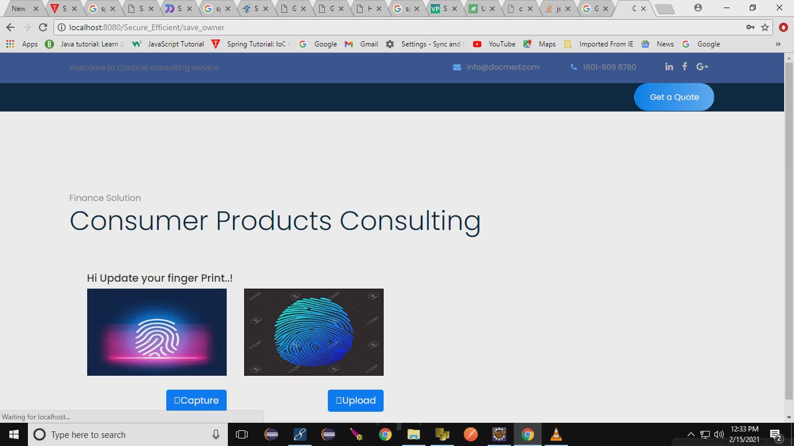

Slide 24
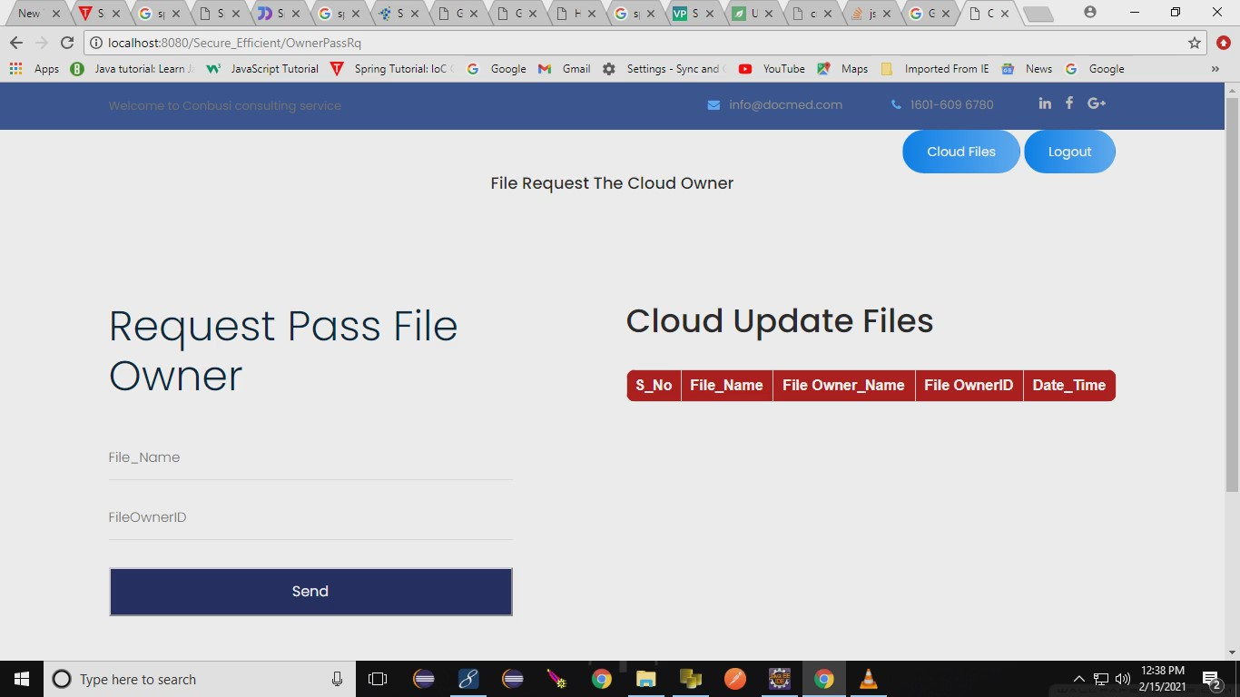

Slide 25
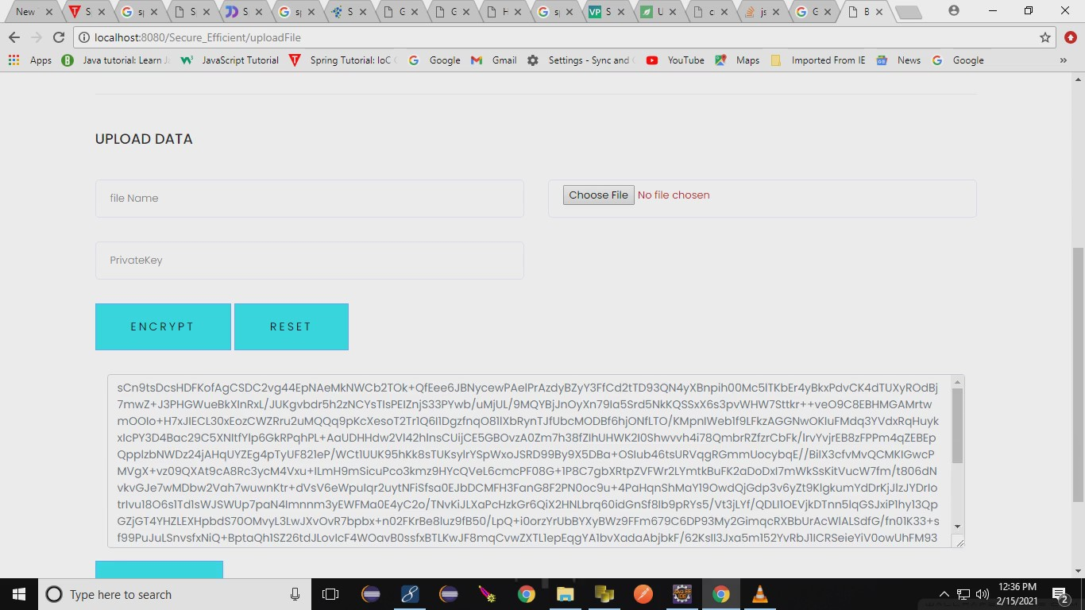

Slide 26
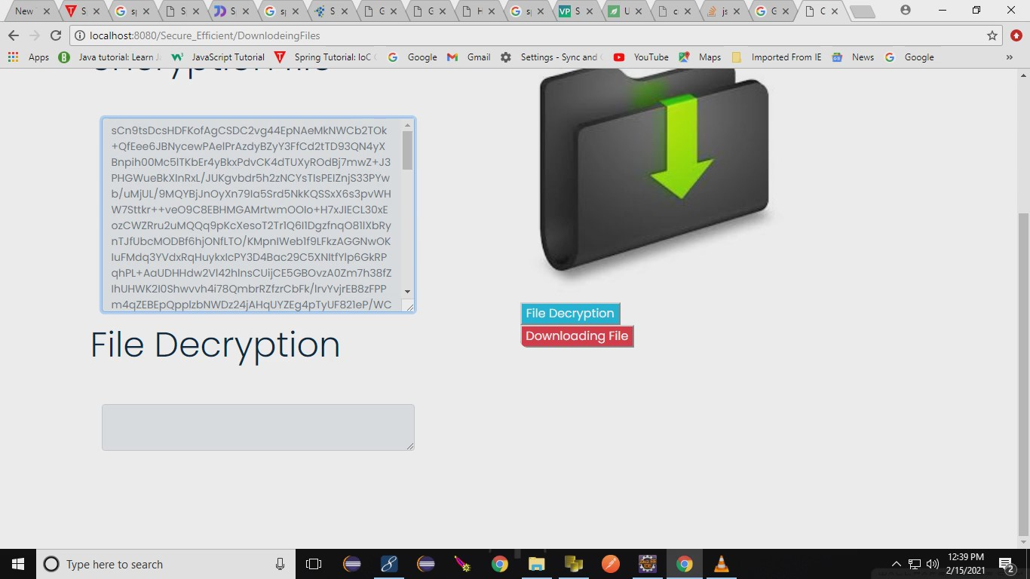

Slide 27
CONCLUSION
To ensure secure and fast communication, existing mechanisms generally use symmetric key cryptography, which requires a number of cryptographic keys to be shared during the authentication process. This strategy results in an overhead to the authentication protocols.
To obtain secure access to the service server, mutual authentication between the user and authentication server, and also between the user and service server have been proposed using a short-term session key.
Using two fingerprint data, we present a fast and robust approach to generate the session key. In addition, a biometric based message authenticator is also generated for message authenticity purpose.
Biometrics has its unique advantages over conventional password and token-based security System, has evidence by its increased adoption.

Slide 28
PUBLICATION
Published in INTERNATIONAL RESEARCH JOURNAL OF MODERNIZATION IN ENGINEERING TECHNOLOGY AND SCIENCE (IRJMETS)
Volume : 03
Issue : 05/May 2021
Impact factor : 5.354
e-ISSN : 2582-5208
Link : https://irjmets.com/rootaccess/forms/uploads/IRJMETS917710.pdf

Slide 29
REFERENCES
Wenchang Yang, Song Wang,Jiankun Hu, Guanglou Zheng and Craig Valli ,”Security and Accuracy of Fingerprint-Based Biometrics: A Review” Received: 2 December 2018; Accepted: 23 January 2019; Published: 28 January 2019
Zhihua Xia, Xingming Sun, Neal N. Xiong ,”A Novel Weber Local Binary Descriptor for Fingerprint Liveness Detection” IEEE Transactions on Systems, Man, and Cybernetics: Systems · January 2018
Srinivas Jangirala, Mohammad Wazid,”Anonymous Lightweight Chaotic Map-Based Authenticated Key Agreement Protocol for Industrial Internet of Things” IEEE Transactions on Dependable and Secure Computing · July 2018
C. Yuan, X. Sun, and Q. M. J. Wu, “Difference co-occurrence matrix using BP neural network for fingerprint liveness detection,” Soft Computing, vol. 23, no. 13, pp. 5157–5169, 2019.
S. Roy, S. Chatterjee, A. K. Das, S. Chattopadhyay, S. Kumari, and M. Jo, “Chaotic Map-Based Anonymous User Authentication Scheme With User Biometrics and Fuzzy Extractor for Crowdsourcing Internet of Things,” IEEE Internet of Things Journal, vol. 5, no. 4, pp. 2884– 2895, Aug 2018.

Slide 30
Jain, A.K.; Flynn, P.; Ross, A.A. “Handbook of Biometrics”; Springer: New York, NY, USA, 2007.
Riaz, N.; Riaz, N.; Riaz, A.; Riaz, A.; Khan, S.A.; Khan, S.A. “Biometric template security: An overview”. Sensor Rev. 2017, 38, 120–127.
Prabhakar, S.; Pankanti, S.; Jain, A.K. “Biometric recognition: Security and privacy concerns. IEEE Secure”. Priv. 2003, 1, 33–42.
Awad, A.I.; Hassanien, A.E. Impact of Some Biometric Modalities on Forensic Science. In “Computational Intelligence in Digital Forensics: Forensic Investigation and Applications”; Springer: Berlin, Germany, 2014; pp. 47–62.
Zheng, G.; Shankaran, R.; Orgun, M.A.; Qiao, L.; Saleem, K. “Ideas and challenges for securing wireless implantable medical devices:” A review. IEEE Sens. J. 2016, 17, 562–576.
Zheng, G.; Fang, G.; Shankaran, R.; Orgun, M.A.; Zhou, J.; Qiao, L.; Saleem, K.” Multiple ECG fiducial points-based random binary sequence generation for securing wireless body area networks.“IEEE J. Biomed. Health Inf. 2017, 21, 655–663.
T. Song, R. Li, B. Mei, J. Yu, X. Xing, and X. Cheng, “A Privacy Preserving Communication Protocol for IoT Applications in Smart Homes,” IEEE Internet of Things Journal, 2017, DOI: 10.1109/JIOT.2017.2707489.
S. Challa, M. Wazid, A. K. Das, N. Kumar, A. G. Reddy, E. J. Yoon, and K. Y. Yoo, “Secure Signature-Based Authenticated Key Establishment Scheme for Future IoT Applications,” IEEE Access, vol. 5, pp. 3028– 3043, 2017

